Slide 1
Lists
Introduction to Lists | Types of Lists | Nested Lists
Notes:
Welcome to our lecture on Lists. In this lecture we will go through the introduction to lists, types of the lists, and nested lists. So let’s start.

Slide 2

Introduction to Lists
HTML lists are used to organize content.
Two types of lists: Ordered lists and Unordered lists.
List items are defined using the <li> tag.
Notes:
HTML lists are essential for organizing content effectively. They come in two types: ordered lists, which use numbers or letters, and unordered lists, which use bullets. Each item within a list is created using the li tag, ensuring a structured presentation. Understanding these types helps in creating clear, easy-to-read web pages that improve user experience and navigation.

Slide 3
Types of Lists
Unordered lists use the <ul> element with <li> items, displayed with bullets.
Ordered lists use the <ol> element with <li> items, displayed with numbers or letters.
The type attribute in <ol> specifies the numbering style (e.g., numbers or letters).
Notes:
There are two main types of HTML lists. Unordered lists, created using the ul tag, display items with bullets. Ordered lists, created using the ol tag, display items with numbers or letters. Additionally, the type attribute in the ol tag lets you specify the numbering style, such as numbers or letters, for ordered lists. These lists help organize content clearly and effectively.

Slide 4
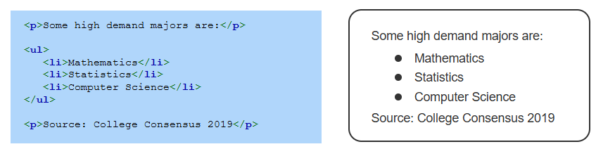
Example of Ordered List
Notes:
This example demonstrates an unordered list created using the ul tag. The list contains items such as Mathematics, Statistics, and Computer Science, each defined using the li tag. The text outside the list is wrapped in p tags to provide additional context, such as a source note. Unordered lists are great for presenting non-sequential items clearly and effectively.

Slide 5
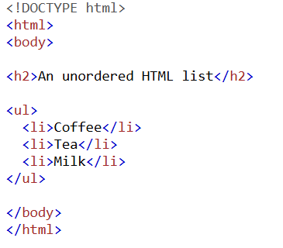
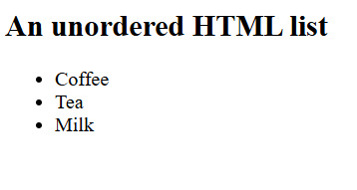
Example of Unordered List
Notes:
The second example shows an unordered list created using the ul tag. It includes items like Coffee, Tea, and Milk, each added using the li tag. The list is introduced with an h2 heading tag to label it as An unordered HTML list. Unordered lists are useful for displaying non-sequential information in a clear, bullet-point format.

Slide 6
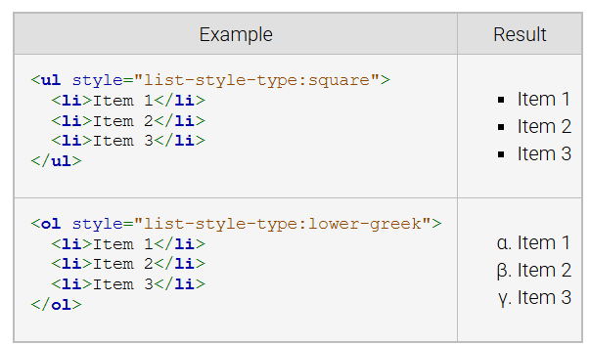
CSS for List Style
The CSS property list-style-type provides the ability to change the bullet used in an unordered list and offers more numbering options in an ordered list.
Notes:
The CSS property list style type allows customization of bullets in unordered lists and numbering styles in ordered lists. For example, setting list style type to square changes bullets to squares, and list style type to lower greek changes numbering to Greek letters. This property enhances the visual presentation of lists to match the design needs of a webpage.

Slide 7
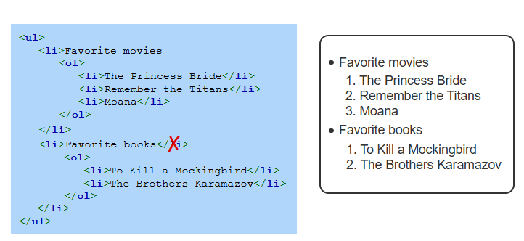
Nested lists
A nested list is a list inside another list. A nested unordered list uses a different bullet style, and a nested ordered list restarts at 1.
Notes:
A nested list is a list within another list, allowing hierarchical organization. In this example, an unordered list contains items such as Favorite movies and Favorite books each with a nested ordered list. Nested unordered lists use different bullet styles, while nested ordered lists restart numbering at 1, creating a structured and clear presentation of grouped items. Thanks for watching the lecture.

